Slide 1
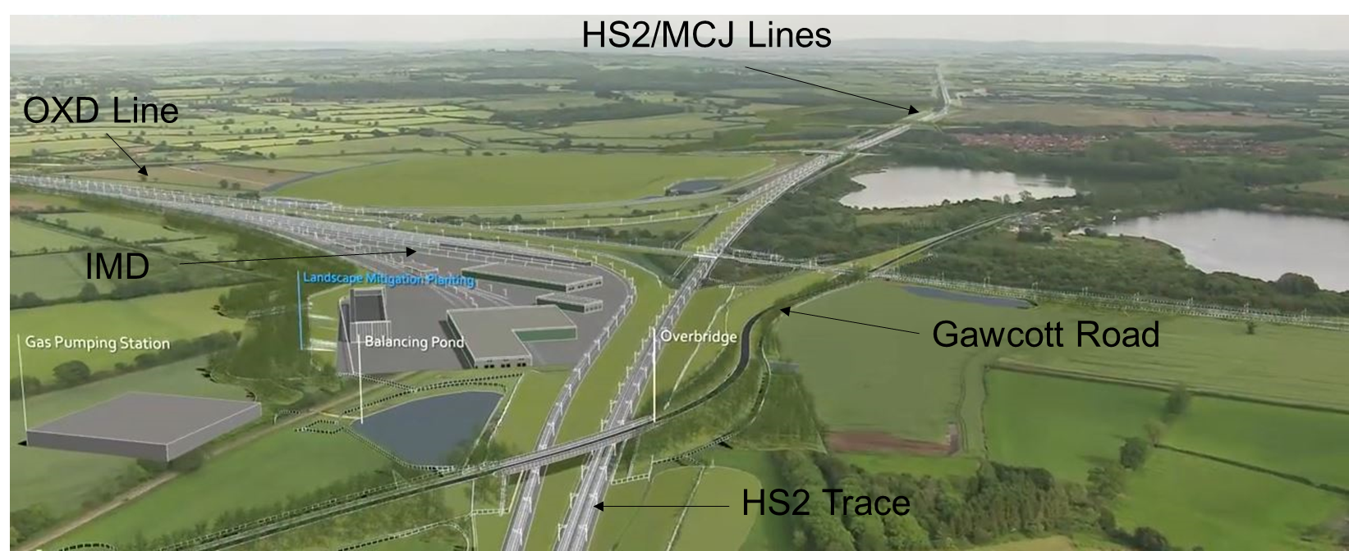
Calvert Area
Liaison Meeting
26th March 2021
Chris James EKFB
Iain Roberts IMD Design
Simon Griffiths Fusion
Thaina Sa’id EWR

Slide 2
Agenda
EKFB Update (40 minutes)
Enquiries, Complaints, Newsletter
Update on rail aggregate delivery
Overview of works
IMD Design Update
Fusion update (20 minutes)
EWR Update (20 minutes)
AOB & next meeting

Slide 3
EKFB HS2 Enquiries Update

Slide 4

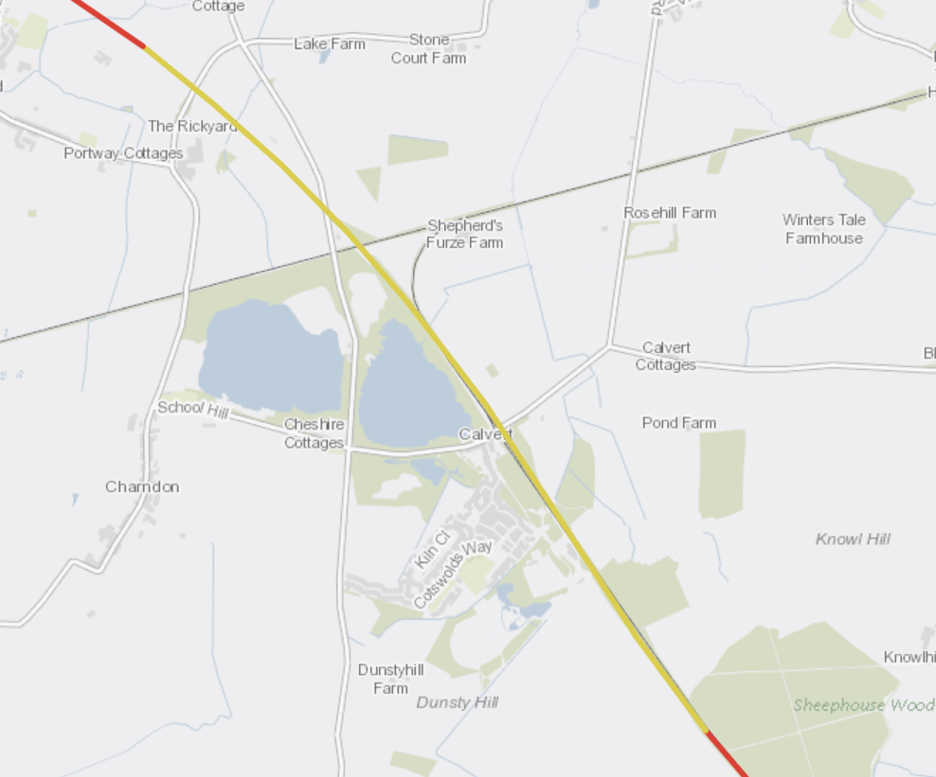

Since our last meeting we received…
4 complaints
3 enquiries through the Helpdesk
HGVs on Gawcott Road
Verge damage
Padbury
Parking/Covid complaint – Co-Op
(Not EKFB or Fusion)
Protestors want their boat back
Security behaviour
You said, we did:
Complaint re Covid concerns (Steeple Claydon Co-Op). We are rolling out a Toolbox Talk on Covid concerns as we ease restrictions.
Concerns around litter. We have carried out several litter picks in the last month where this has been reported to us.
Gawcott Road. We are in the process of getting a ‘No HS2 traffic’ sign installed on A421.
4x4 driving, Addison Rd compound (Fusion)

Slide 5
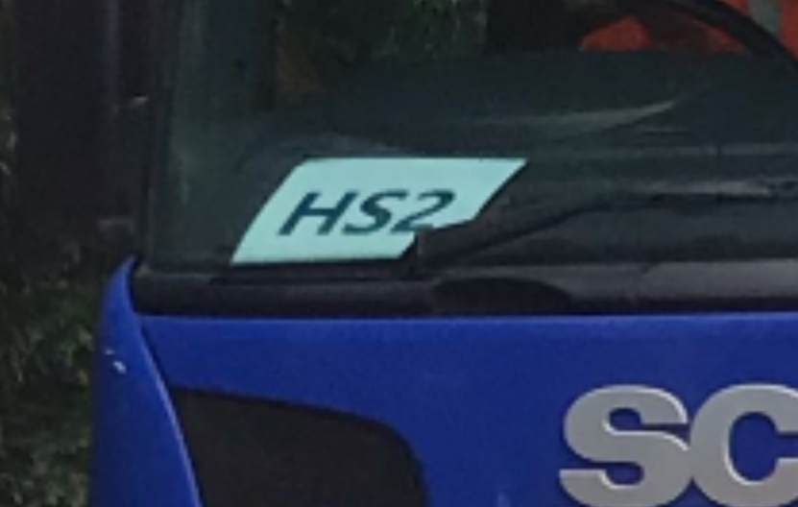
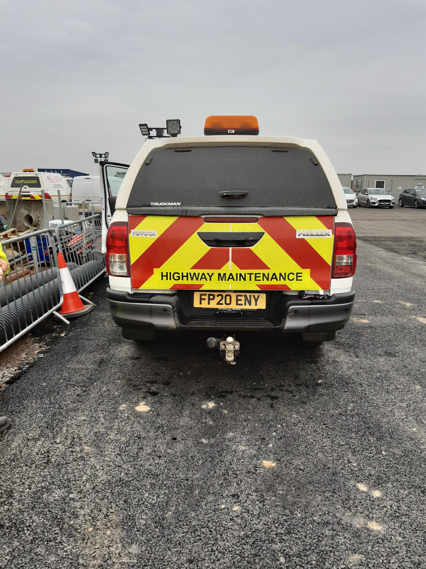
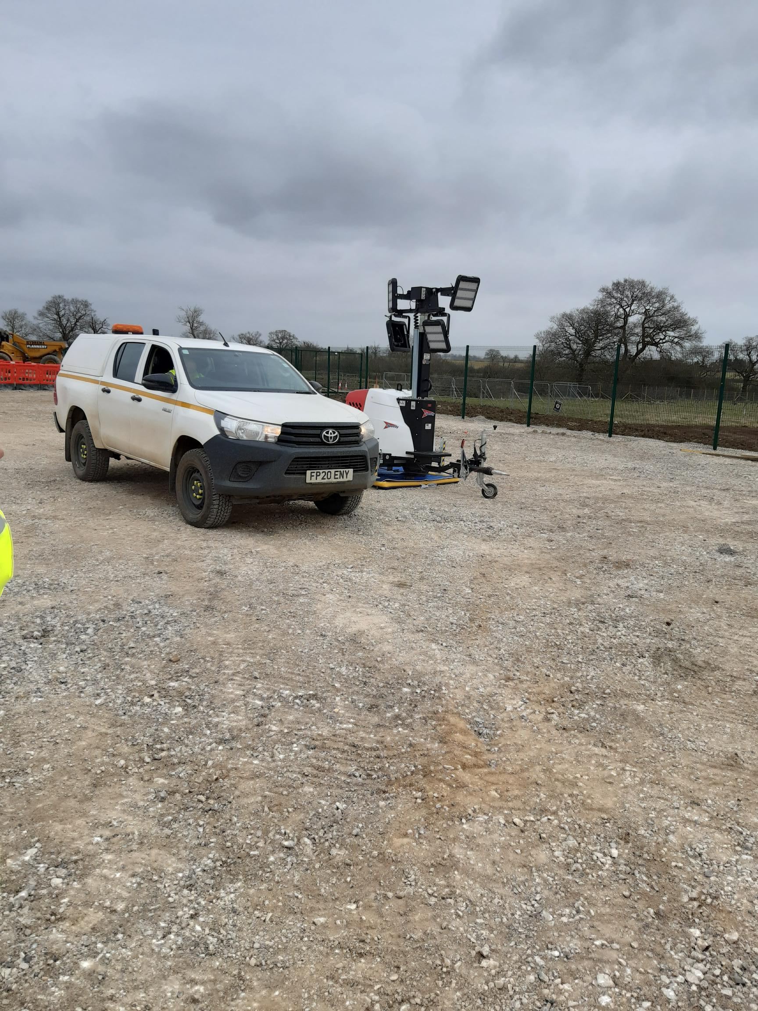
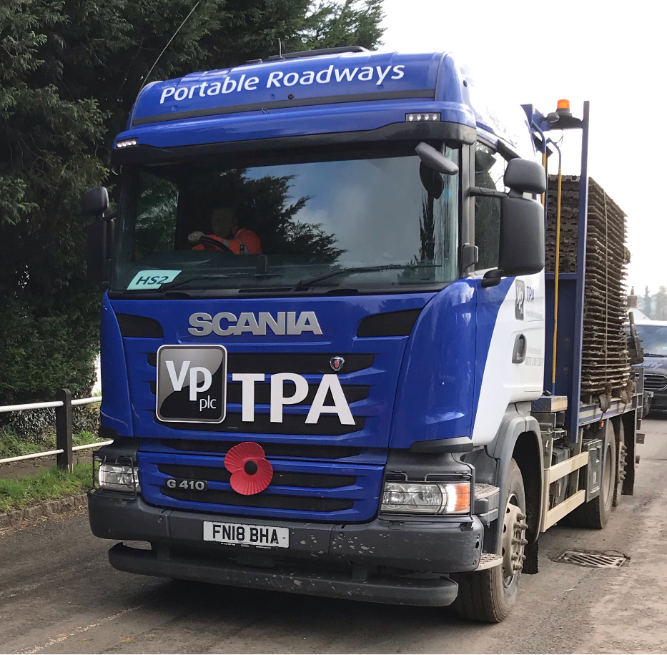
EKFB vehicles…

Slide 6
EKFB Main Works Update

Slide 7
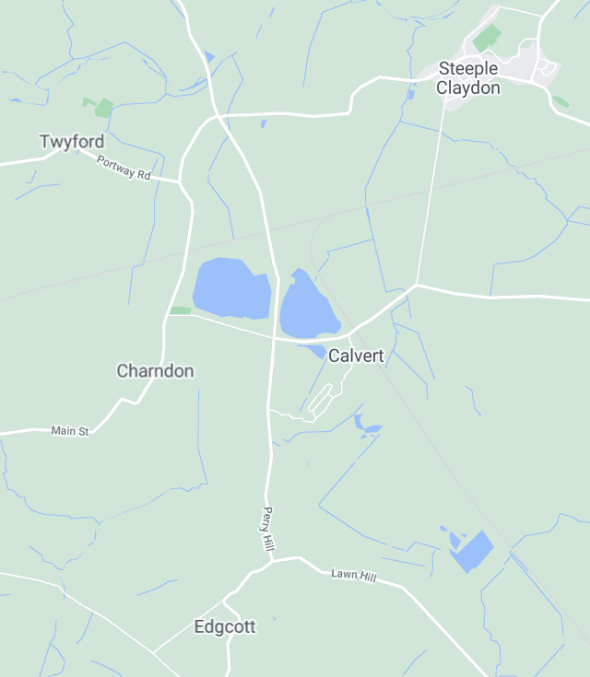
Operational Overview
4
EKFB
1
Compound & Infrastructure
Aggregate delivery by Rail – next step FCC
Ground investigation & underground services
Archaeology
Woodland translocation & planting
Works Compound
Underground Services
Road Closures
7
3
4
2
6
Fusion
7
3
5
EWR

Slide 8
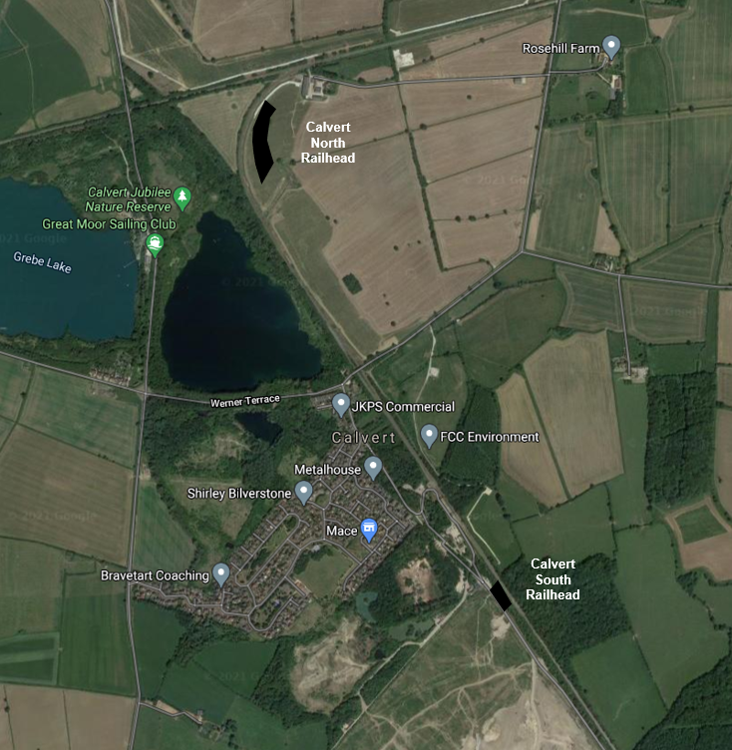
Rail head North
Rail deliveries until June
Monday to Friday Approximate times:
07.30 hrs
13.30 hrs.
16.30 hrs.
Saturday
Occasional, times vary
Up to two trains
No unloading before 08.00 hrs.

Slide 9
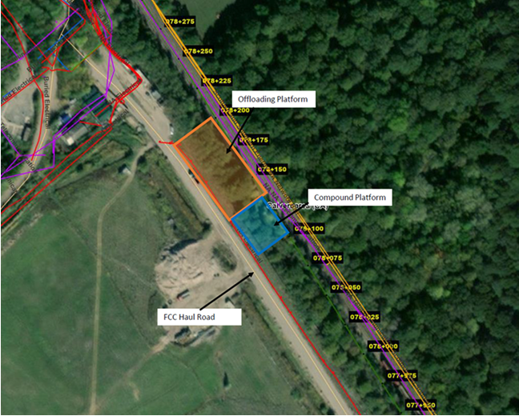
Rail head South
Rail deliveries to start June
Form compound platform
Offloading platform
Running in June

Slide 10
Traffic

Slide 11
March – Last 2 weeks
1
Increase in EKFB HGV Traffic Daily Deliveries
West Street - 10 / 20 deliveries daily
School Hill – 10 /20
Shipton Lee – some days at maximum
3
2

Slide 12
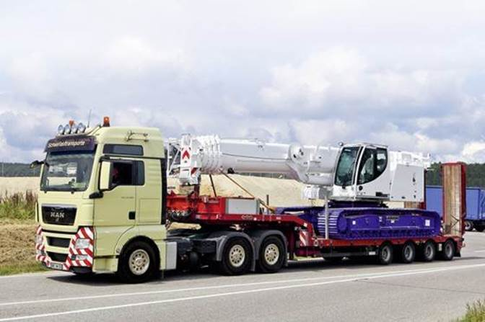
Abnormal Loads
Deliveries continue
Construction plant for piling and earthworks activities

Slide 13
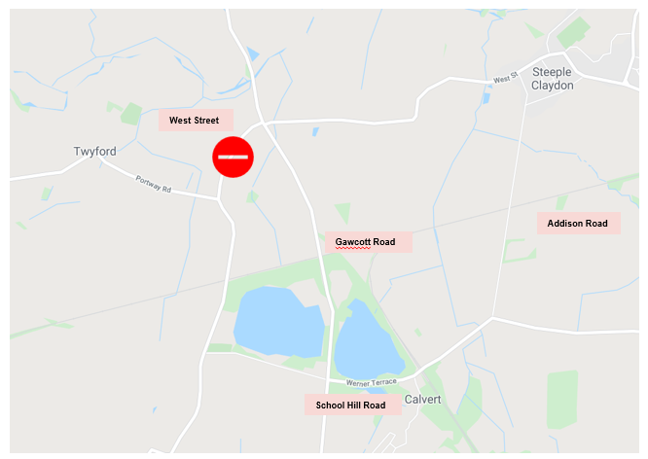
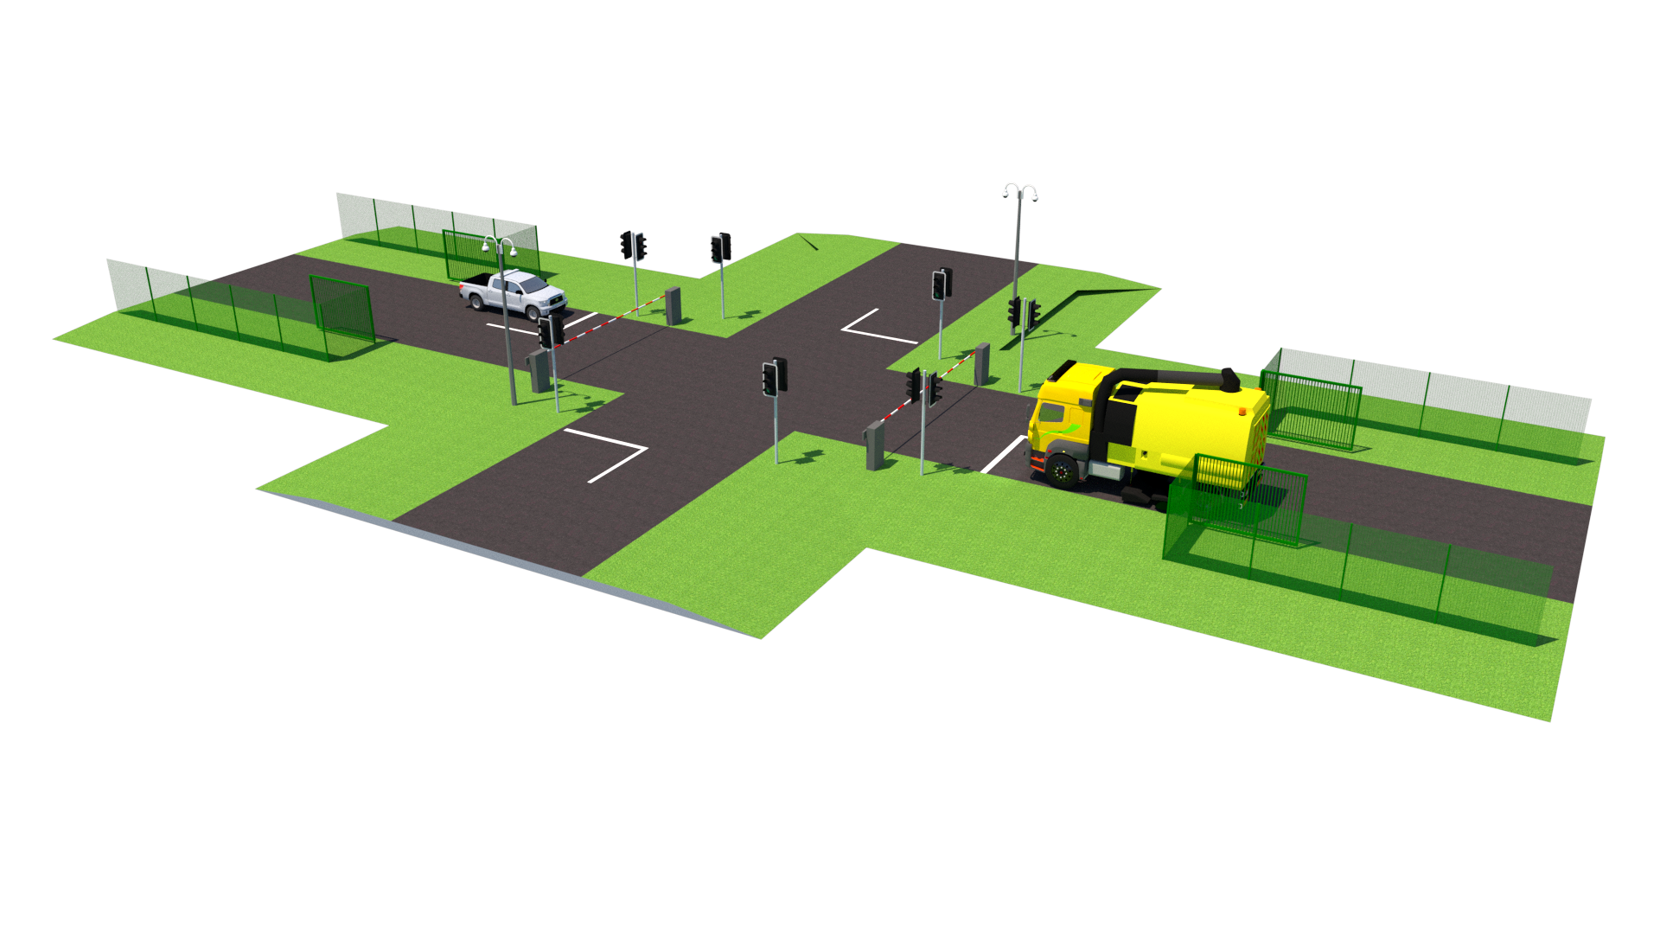
Road Closure Strategy
West Street, long term to build bridge.
Langsdon & Tasker Update
Gawcott road. Traffic lights, crossing, short term closures for tie in work.

Slide 14
Road Crossing

Slide 15
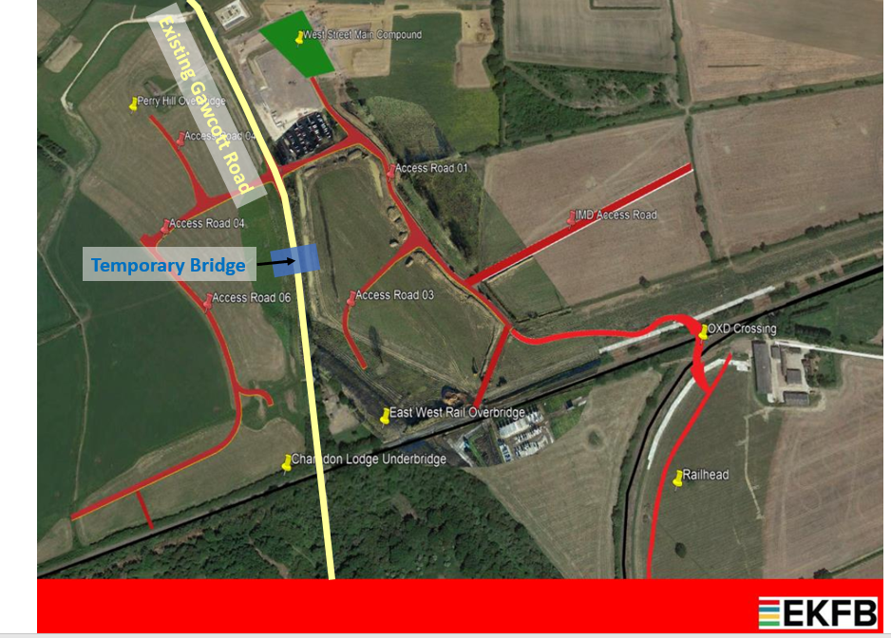
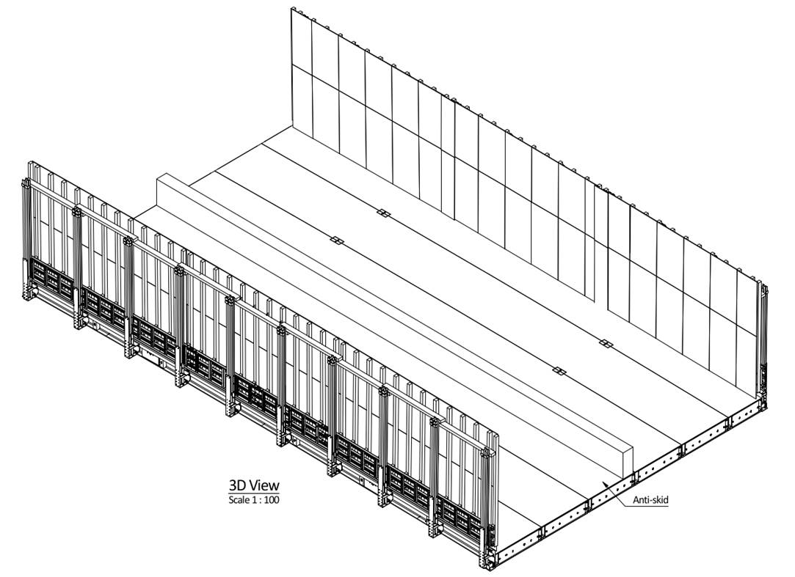
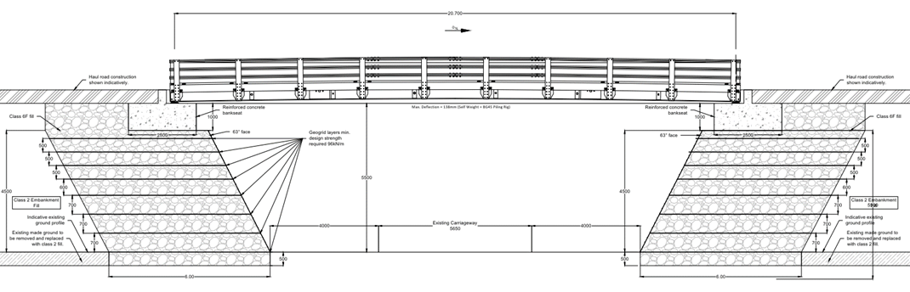
Temporary Bridge

Slide 16
Calvert Area
Liaison Meeting
26th March 2021
Chris James EKFB
Iain Roberts IMD Design
Simon Griffiths Fusion
Thaina Sa’id EWR

